Slide 1

Recognizing Traffic Signs Using Deep Learning
Indian Institute of Management, Ahmedabad
Ashish Panchal Tanmay Jain Santosh Shinde
2239973 2239954 2239960

Slide 2
Acknowledgement
It is my immense pleasure to thank our Mentor Mr. Ankur Sinha, Faculty, Indian Institute of Management, Ahmedabad campus for his valuable feedback during this work.
Finally, We would like to express thanks to all my friends who helped in different ways to accomplished this Project.

Slide 3
Abstract
Problem Statement
Classification of German Traffic Sign Recognition Benchmark dataset.
Challenges
Wide variability in visual appearance. Illumination , weather condition, partial occlusions
Goal
High accuracy in recognizing signs in real world.
Approach
For this project, we aimed to investigate the performance of different classification algorithms' accuracy for Visual recognition problem of classifying traffic signs. We have exploited Support Vector Machine (SVM), Multi-Layer Perceptron (MLP), and deep learning algorithms such as LeNet-5, VGGNet, which are used and trained on German traffic sign images and then classify the unlabeled traffic signs.

Slide 4
Engineering Methodology
Dataset Summary
Dataset Exploration
Data Preprocessing
Learning Algorithm
Converted raw data into Dictionary like object with 4 key/value pairs and stored in pickle format .
Typical pickled data:
'features' is a 4D array containing raw pixel data of the traffic sign images.
'labels' is a 2D array containing the label/class id of the traffic sign.
'sizes' is a list containing tuples, \ original width and height the image.
'coords' is a list contains bounding box coordinates
Provide the number of images in each subset, in addition to the image size, and the number of unique classes.
Number of training examples: 34799
Number of testing examples: 12630
Number of validation examples: 4410
Image data shape: (32, 32, 3)
Number of classes: 43
Input : Image(.ppm)
Preprocessing of an image will enhance the properties of image like brightness, hue, contrast and saturation.
Shuffling: To increase randomness and variety in training dataset, in order for the model to be more stable.
Grayscaling: Using grayscale images instead of color improves the ConvNet's accuracy.
Local Histogram Equalization: To enhance images with low contrast.
Normalization: Changes the range of pixel intensity values, to mean zero and equal variance.
Apply different classifiers
Support Vector Machine
Multi Layer Perceptron
Convolutional Network:
LeNet-5
VGGNet

Slide 5
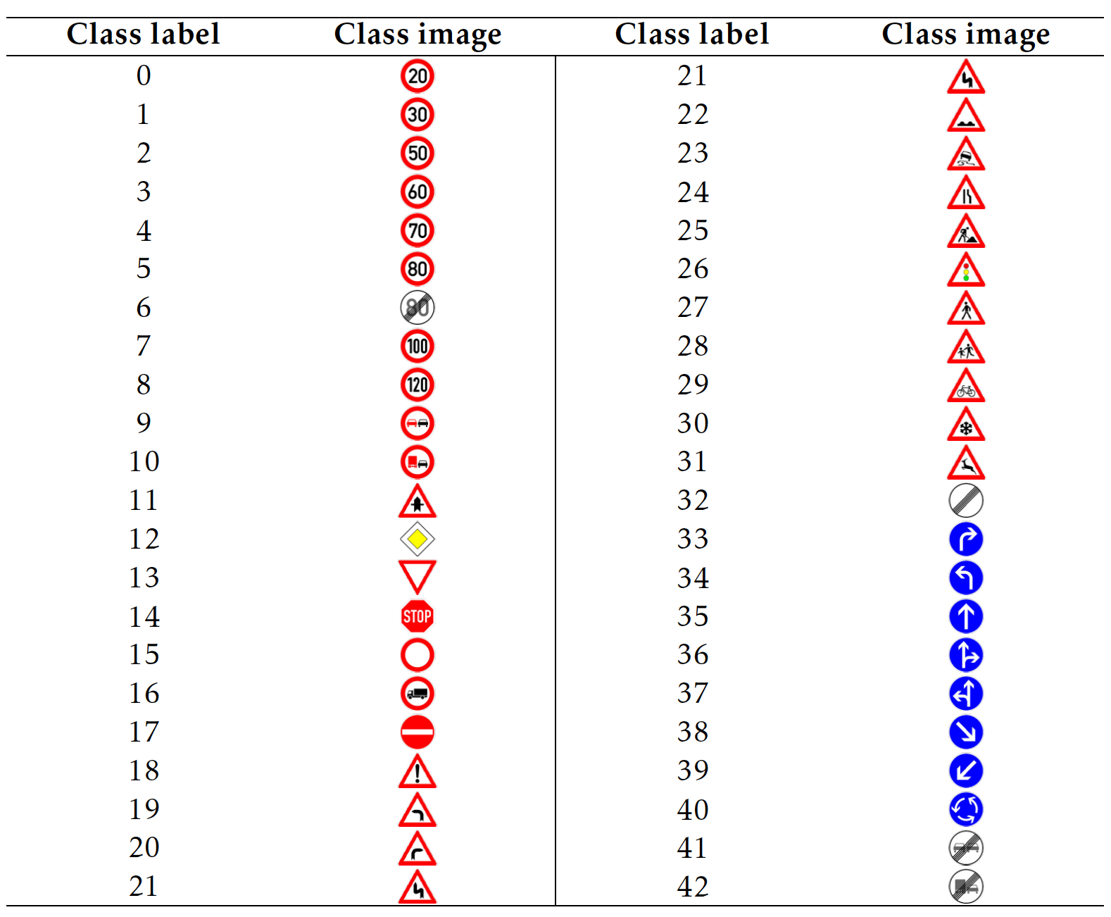
Dataset Summary
Where we get data from?
The German Traffic Sign Recognition Benchmark (GTSRB)
http://benchmark.ini.rub.de/?section=gtsrb&subsection=news
Dataset Overview
The GTSRB dataset contains 51839 images of German traffic signs labeled with 43 different classes. The sizes of the image patches vary from 15×15 to 222×193 pixels and contain a margin of 10% around the traffic signs. Training, validation, and testing dataset in pickle format. Each dataset contains number of images and its label. Single-image, multi-class classification problem.
----- Complete Basic Data Summary -----
Image data shape = (32, 32, 3)
Number of classes = 43
Number of training examples: 34799
Number of testing examples: 12630
Number of validation examples: 4410

Slide 6
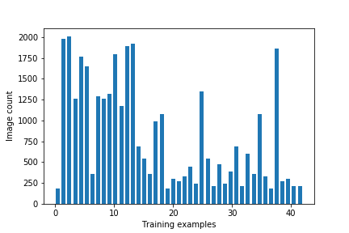
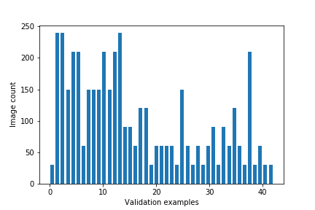
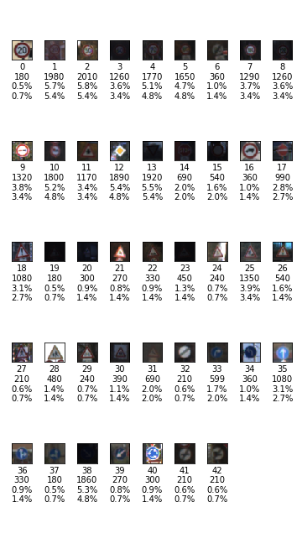
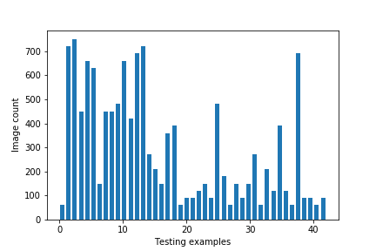
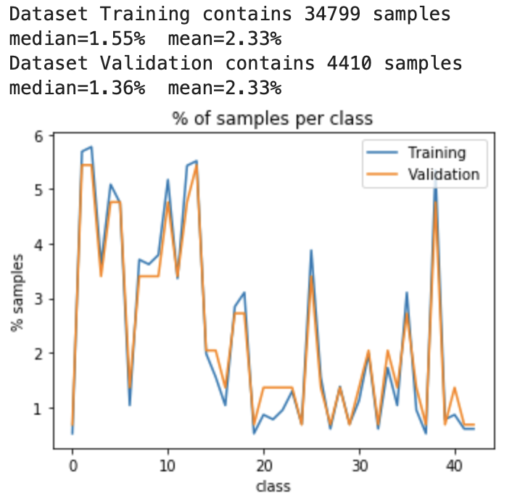
Dataset Exploration
Inferences from the data exploration that we had tackled during the pre-processing stage:
Class bias issue as some classes seem to be underrepresented
Image contrast seems to be low for lot of images

Slide 7
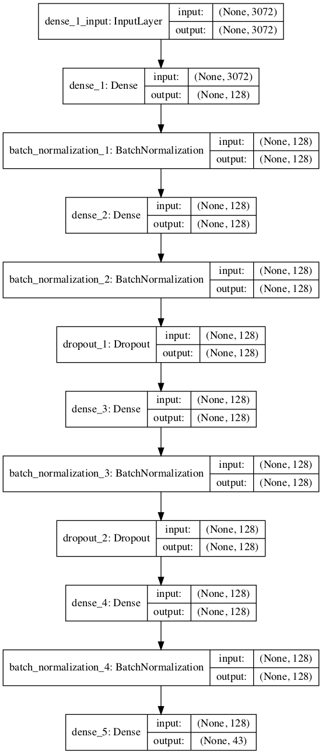
Data Preprocessing – Setting Baseline
Before we did any data preprocessing, we have developed a simple dense network to baseline quality of data on basis of network (model) accuracy.
The evaluation metric we have used for our model is “accuracy” score.
The input shape is 32*32*3 (as images have 3 color channels). The number of parameters on the first layer would be 393344 ((32*32*3*128) + 128)).
There are 4 hidden layers of 128 neurons with ReLU activation and after each hidden layer except the last one a dropout (50%) function is included.
The output layer has the softmax activation since we are dealing with multi class classification and there are 43 classes.
The Sample baseline model was able to achieve an accuracy score of 86% without any preprocessing.

Slide 8
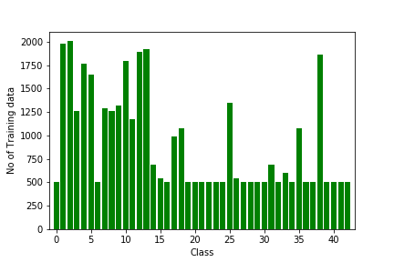
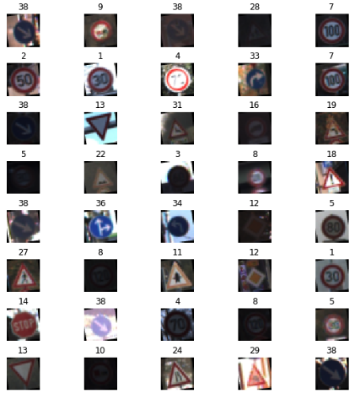
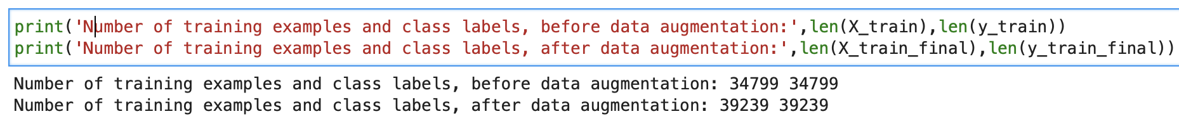
Data Preprocessing
We have applied several preprocessing steps to the input images to achieve the best possible results. we have used the following preprocessing techniques:
Data Augmentation
To address the class bias issue to same extent we increased images for those classes which were less than 500 in numbers.
Slight Rotation of Images
We used 10 degrees rotation of images. It would not make much sense to rotate images more than that as that might lead to wrong representations of the traffic signs.
Image Translation
This is a technique by which you shift the location of the image. In layman terms, if the image’s location is (x1,y1) position, after translation it is moved to (x2,y2) position.

Slide 9
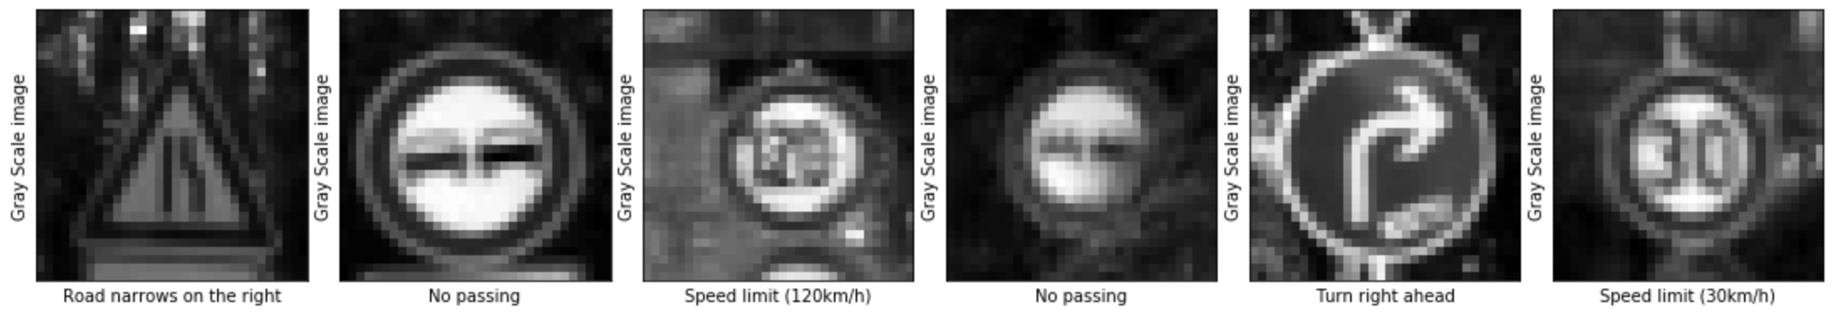
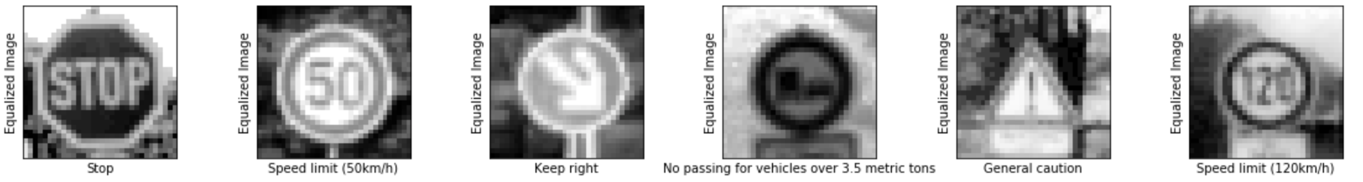
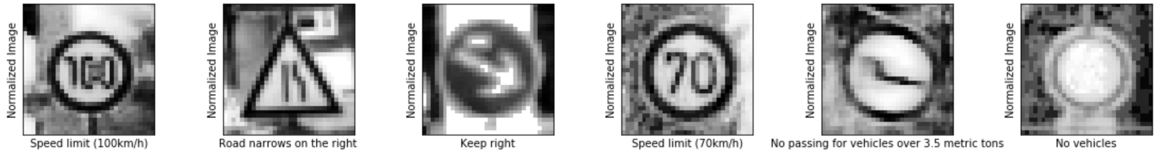
Data Preprocessing
Grayscaling: Gray scaling of images is done to reduce the information provided to the pixels and reduces complexity.
Local Histogram Equalization: This is done to increase the contrast of the images as we had identified during “Data exploration” that the images might need an increase in contrast.
Normalization: This is to changes the range of pixel intensity values. Usually the image data should be normalized so that the data has mean zero and equal variance.

Slide 10
Learning Algorithms
We have picked up supervised learning algorithms from basic to deep learning to classify GTSRB signs. We have applied Support Vector Machine (SVM), Multi-Layer Perceptron (MLP), LeNet-5, and VGGNet.
Support Vector Machine
It is a supervised machine learning algorithm, It follows a technique called the kernel trick to transform the data and based on these transformations, it finds an optimal boundary between the possible outputs.
Multi-Layer Perceptron
Unlike other classification algorithms such as Support Vectors or Naive Bayes Classifier, MLP Classifier relies on an underlying Neural Network to perform the task of classification. A multilayer perceptron (MLP) is a feedforward artificial neural network model that maps sets of input data onto a set of appropriate outputs.
Lenet-5
LeNet-5 is a convolutional network designed for handwritten and machine-printed character recognition. The LeNet-5 architecture consists of two sets of convolutional and average pooling layers, followed by a flattening convolutional layer, then two fully connected layers and finally a softmax classifier.
VGGNet
The original VGGNet architecture has 16-19 layers, but I've excluded some of them and implemented a modified version of only 12 layers to save computational resources.

Slide 11
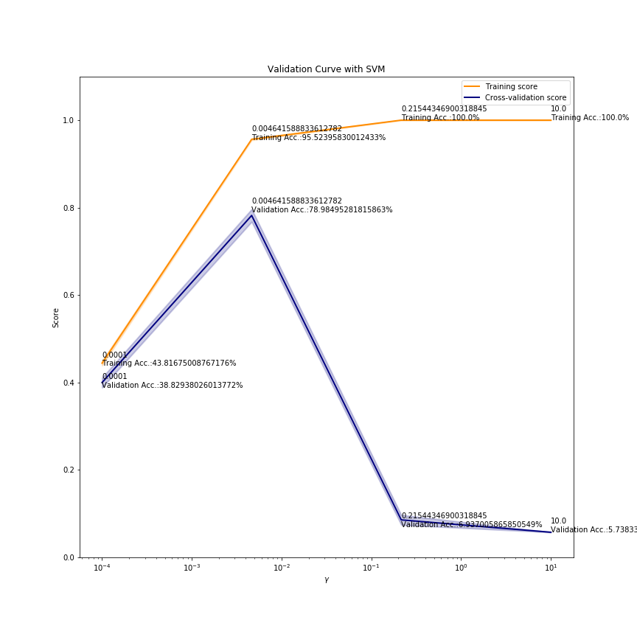
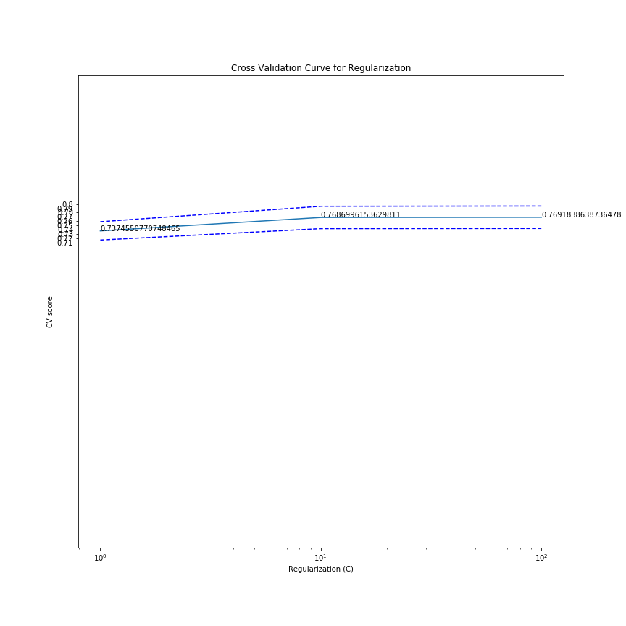
Learning Algorithms – SVM - Hyper-parameters Tuning
Choosing Right values of Gamma(𝛾) for Gaussian (rbf) Kernel
Choosing Right values of Regularization(C) for Gaussian (rbf) Kernel
As left side plot shows that, training scores and validation scores of an SVM for different values of the kernel parameter gamma(𝛾) we can conclude following:
For very low values of gamma(𝛾γ), both the training score and the validation score are low. This is called underfitting.
Medium values of gamma(𝛾γ) will result in high values for both scores, i.e. the classifier is performing fairly well.
If gamma(𝛾) is too high, the classifier will overfit, which means that the training score is good, but the validation score is poor.
With our dataset, we have gamma (𝛾) as 0.0046415888, because this point training accuracy is 92.62 % and validation accuracy is 70.24 %, we have chosen Regularization ( C ) as 100 because form right side plot Cross-Validation score is 0.76918386 which higher than other C values.

Slide 12
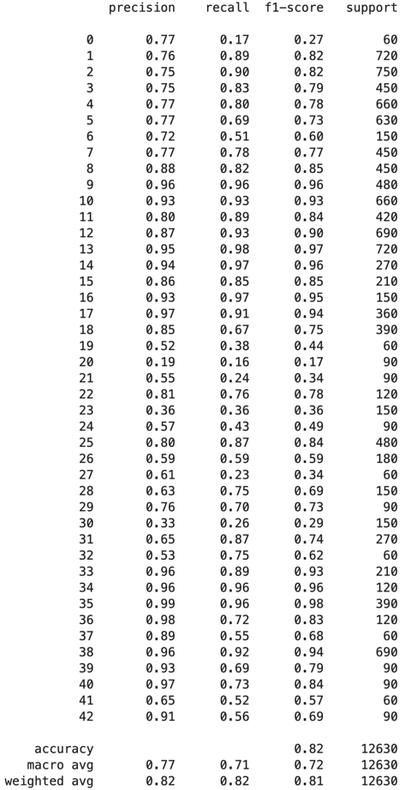
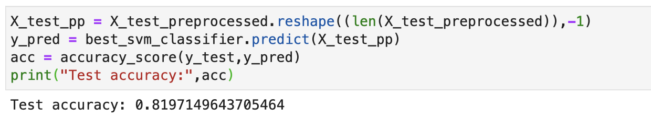
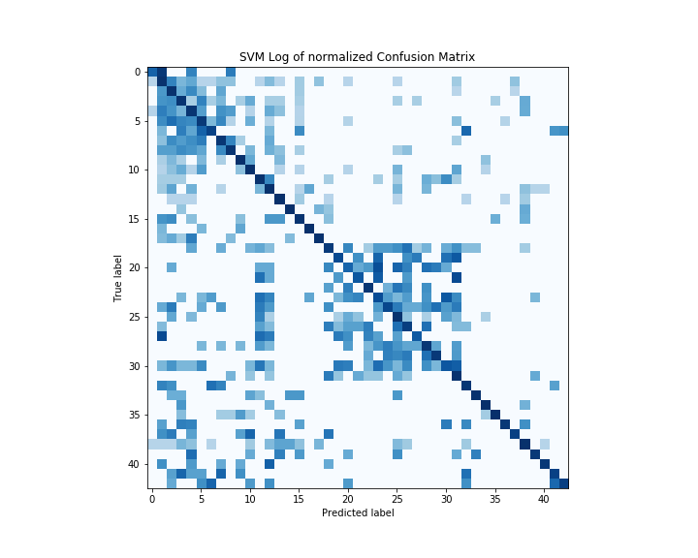
Learning Algorithms – SVM - Matrix
Accuracy with Test dataset:
Confusion Metric
Our final SVM model has achieved test accuracy of 81.97%.
Conclusion from Confusion Metric chart, we see many clusters but predominately there two clusters. First clusters around classes 0 – 10 and second is around classes 20 – 32, and these classes range turned out to be speed limits signs and some road signs with triangular shapes.
So our model is misclassified speed signs among themselves and signs with triangular shapes.

Slide 13
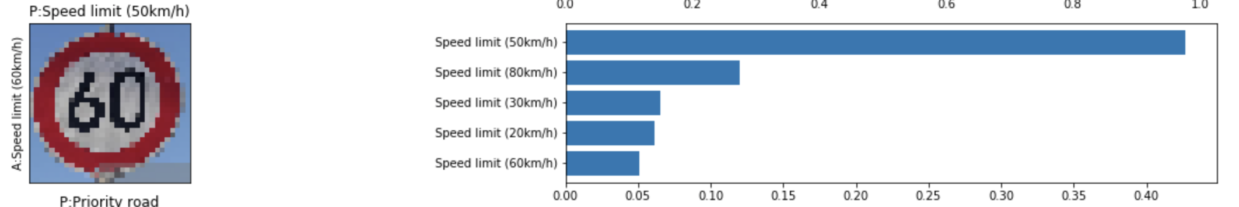
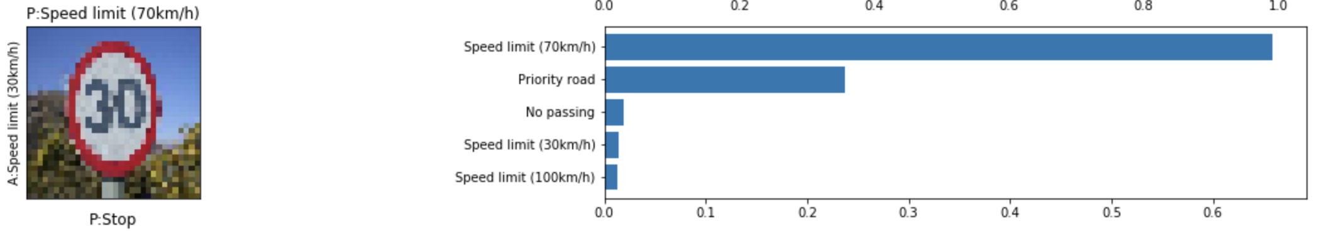
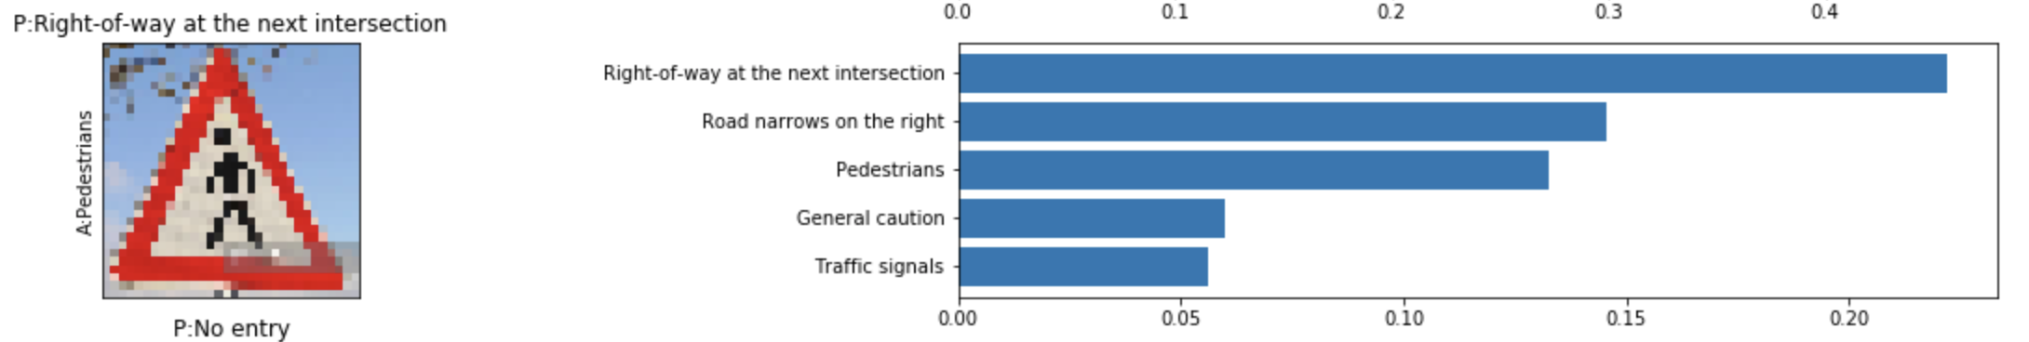
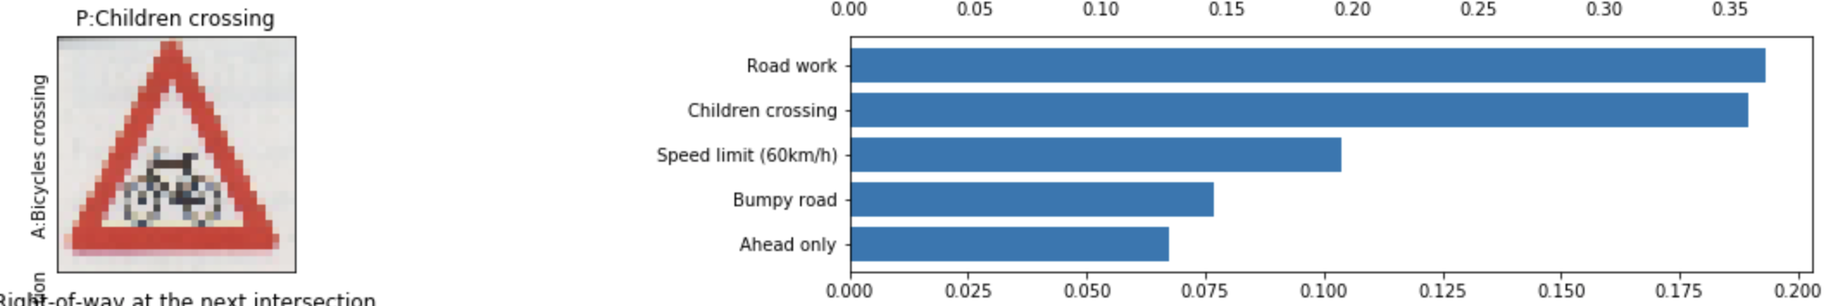
Learning Algorithms – SVM – New Images
In order to verify observation we derived from the confusion matrix we created bunch of images which model has never seen at all.

Slide 14
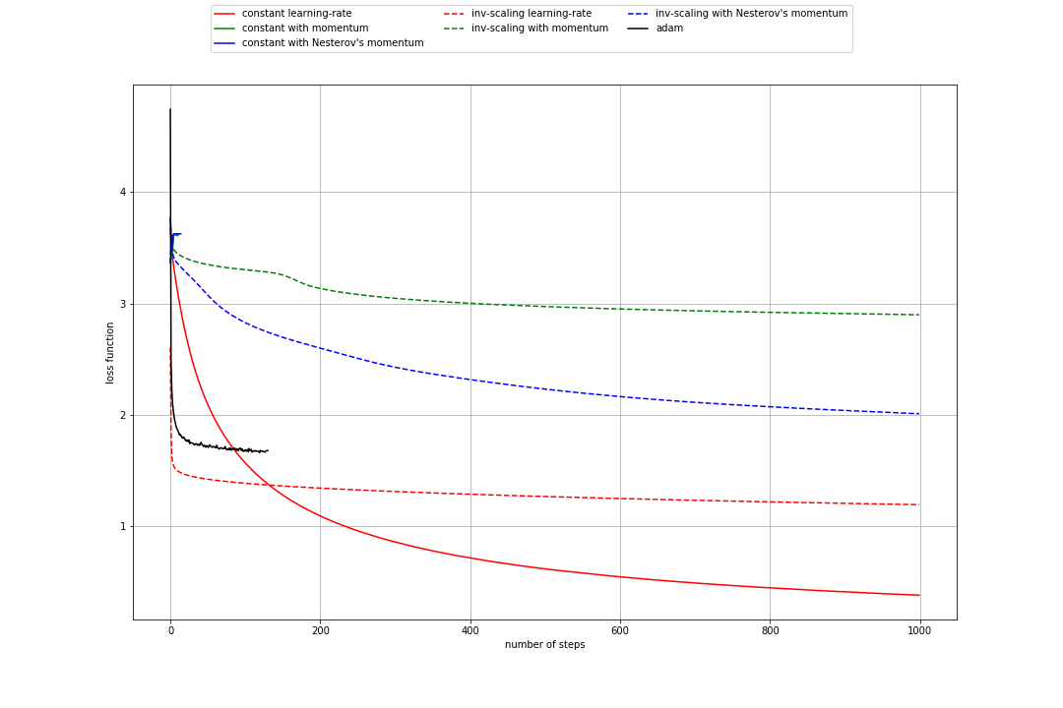
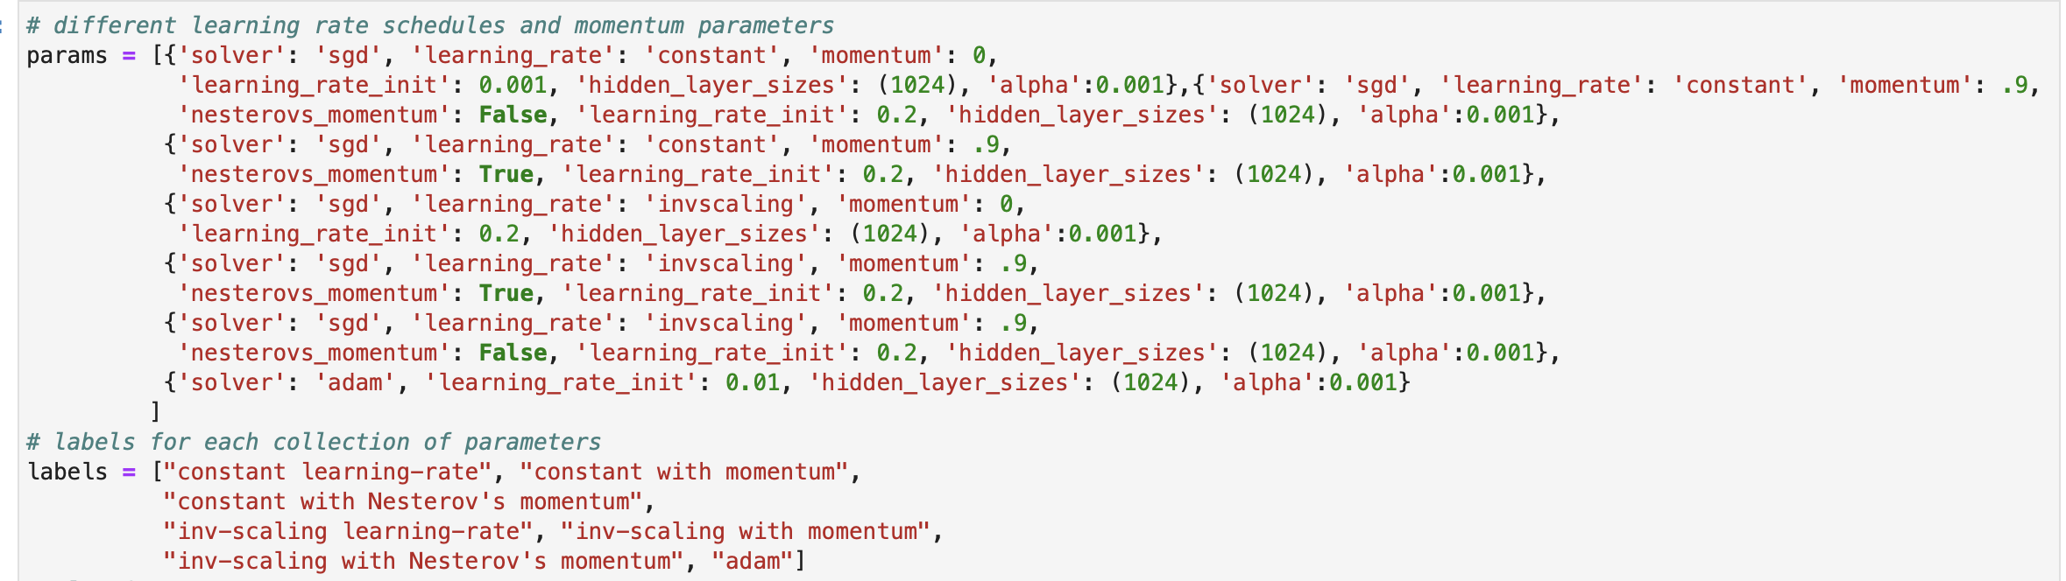
Learning Algorithms – Multi-Layer Perceptron
We have used Random Search Parameter Tuning; Random search is an approach to parameter tuning that will sample algorithm parameters from a random distribution (i.e. uniform) for a fixed number of iterations. We have tried RandomizedSearchCV to find optimized set of hyper-parameters. we tried following combination:
Best Parameter found is: {'solver': 'sgd', 'max_iter': 1000, 'hidden_layer_sizes': (1024,), 'alpha': 0.001}
Constant Learning Rate has good learning rate.

Slide 15
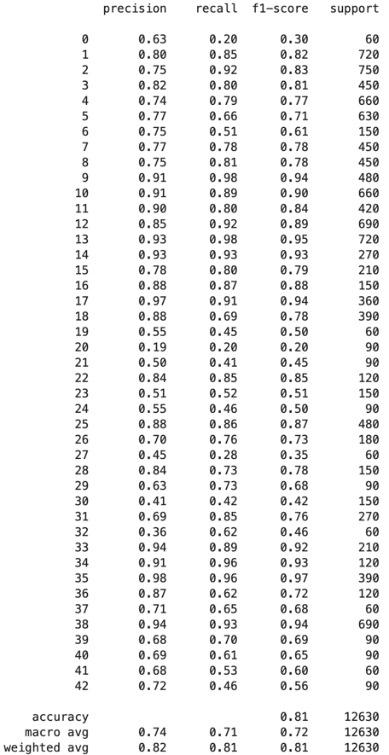
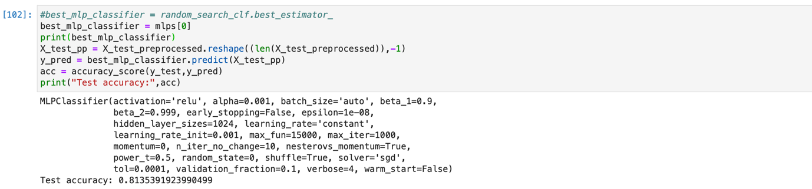
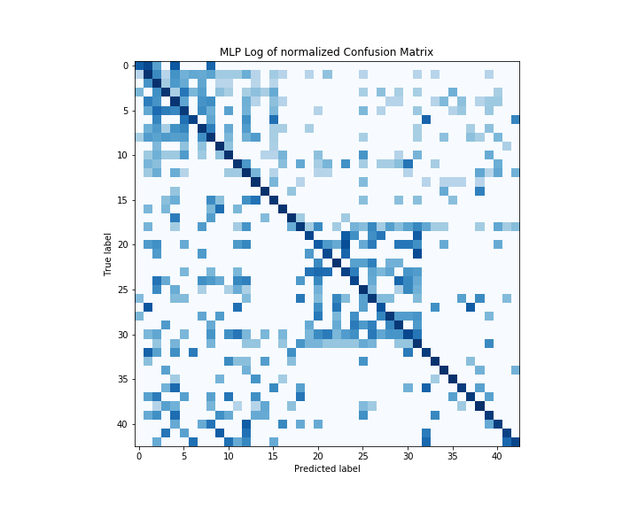
Learning Algorithms – MLP - Matrix
Accuracy with Test dataset:
Confusion Metric
Our final MLP model has achieved test accuracy of 81.35%.
Conclusion from Confusion Metric chart, we see many clusters but predominately there two clusters. First clusters around classes 0 – 10 and second is around classes 20 – 32, and these classes range turned out to be speed limits signs and some road signs with triangular shapes.
So our model is misclassified speed signs among themselves and signs with triangular shapes.

Slide 16
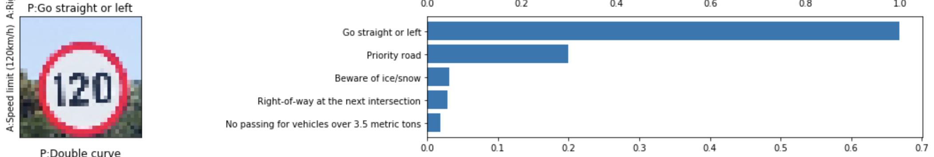
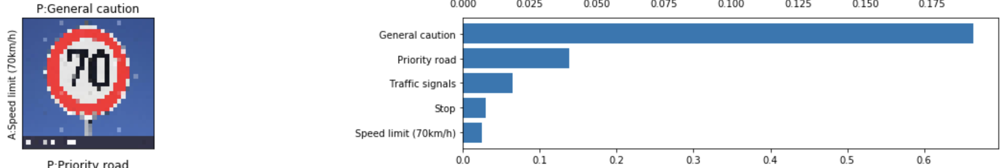
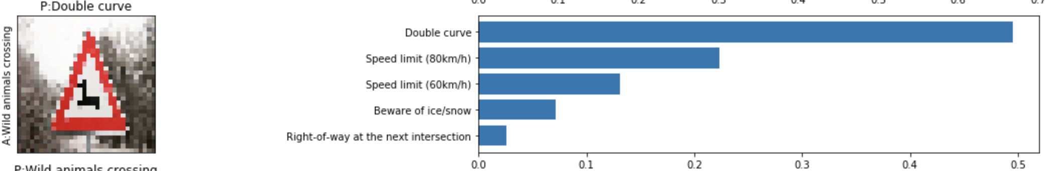
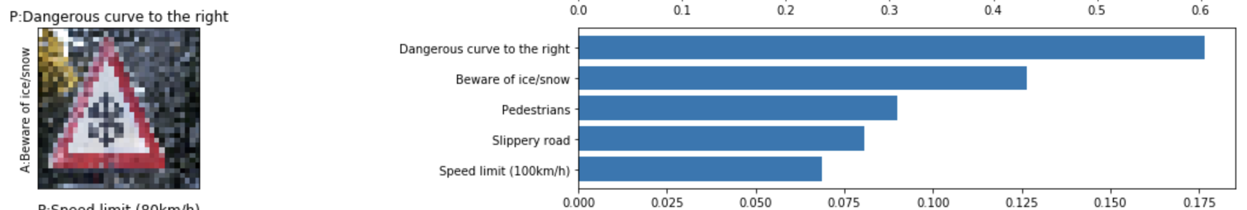
Learning Algorithms – MLP – New Images
In order to verify observation we derived from the confusion matrix we created bunch of images which model has never seen at all.

Slide 17
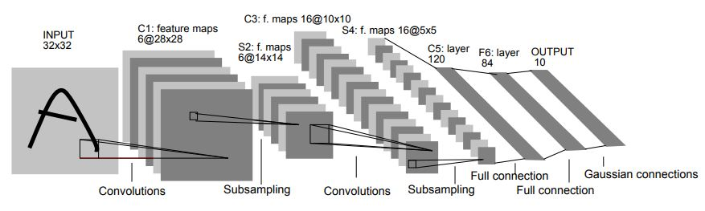
Learning Algorithms – LeNet-5
It consists of two sets of convolutional and average pooling layers, followed by a flattening convolutional layer, then three fully connected layers and finally a softmax classifier.
Image => Convolution => ReLU => Pooling => Convolution => ReLU => Pooling => FullyConnected => ReLU => FullyConnected
Layer 1 (Convolutional):
Filter: 5×5
Stride: 1
Output: 28x28x6
Activation: ReLU
Pooling: The output: 14x14x6
Layer 2 (Convolutional):
Filter: 5×5
Stride: 2
Output: 10x10x16
Activation: ReLU
Pooling: The output: 5x5x16
Flattening: Flatten the pooling layer output shape such that it's 1D instead of 3D.
Layer 3 (Fully Connected): The output :120
Activation: ReLU
Layer 4 (Fully Connected): the output: 84
Activation: ReLU
Layer 5 (Fully Connected): The Final output: 43

Slide 18
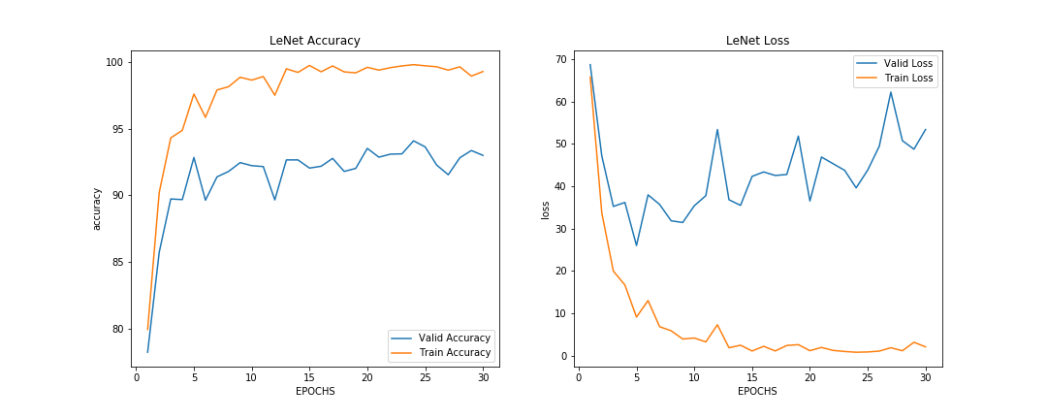
Learning Algorithms – LeNet-5 – Performance Curve
EPOCH 30 : Training Accuracy = 99.269%
EPOCH 30 : Training Loss = 2.089%
EPOCH 30 : Validation Accuracy = 92.993%
EPOCH 30 : Validation Loss = 53.410%

Slide 19
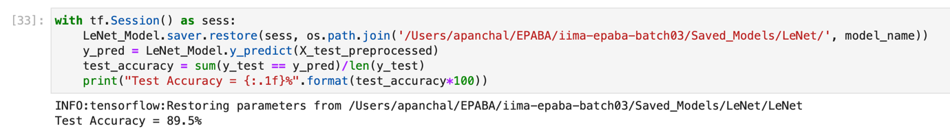
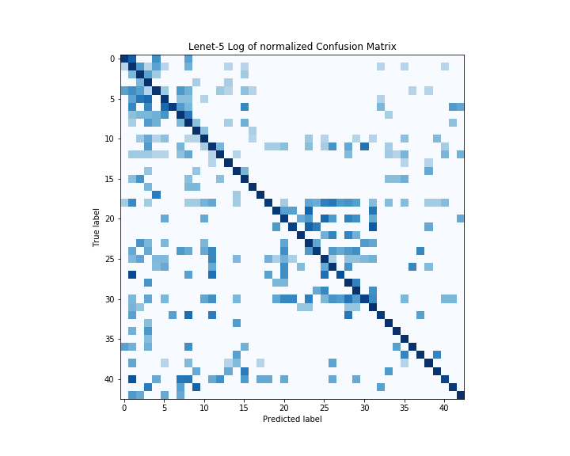
Learning Algorithms – LeNet-5 - Matrix
Accuracy with Test dataset:
Confusion Metric
Our final Lenet-5 model has achieved test accuracy of 89.5%.
Conclusion from Confusion Metric chart, we less clusters compare to SVM and MLP but predominately there two clusters. First clusters around classes 0 – 10 and second is around classes 23 – 32, and these classes range turned out to be speed limits signs and some road signs with triangular shapes.
So our model is misclassified some of the speed signs among themselves and signs with triangular shapes.

Slide 20
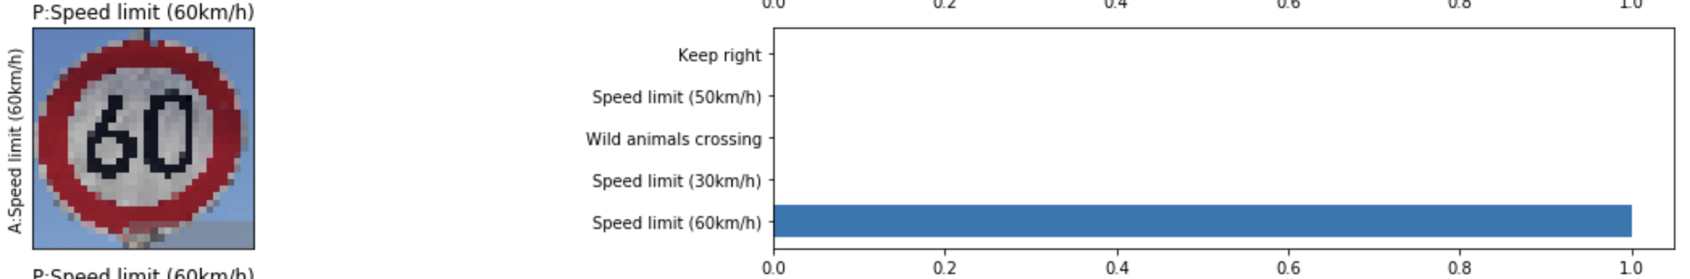
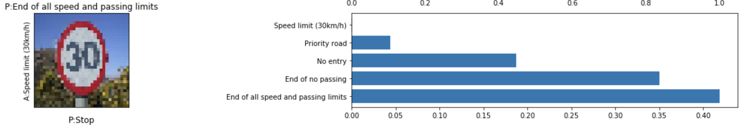
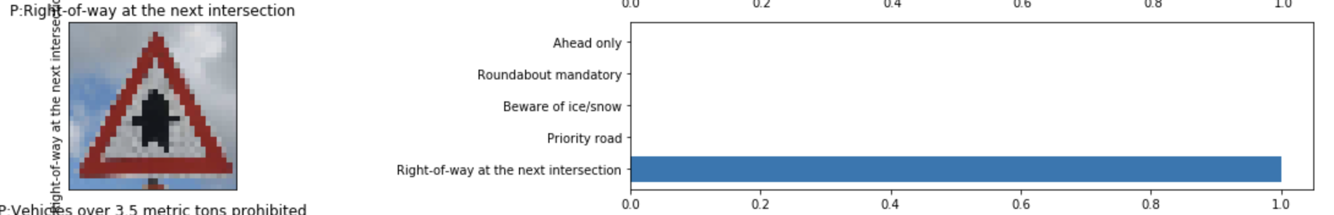
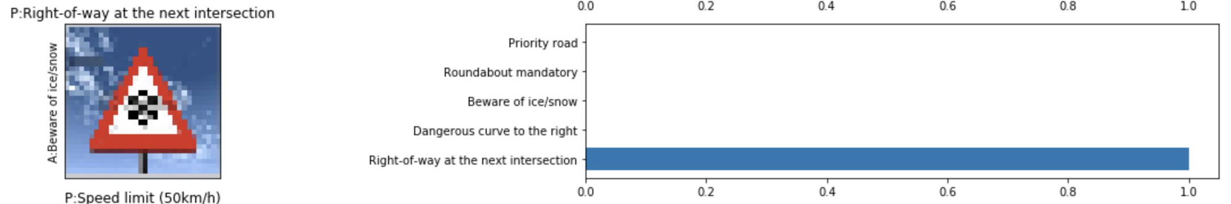
Learning Algorithms – LeNet-5 – New Images
In order to verify observation we derived from the confusion matrix we created bunch of images which model has never seen at all.

Slide 21
Learning Algorithms – VGGNet
We have made some modification in original VGGNet architecture, by reducing last four layers (original VGGNet architecture has 16-19 layers) and kept only 12 layers to accommodate with available computational resources.
Image => Convolution => ReLU => Convolution => ReLU => Pooling => Convolution => ReLU => Convolution => ReLU => Pooling => Convolution => ReLU => Convolution => ReLU => Pooling Layer => FullyConnected => ReLU => FullyConnected => ReLU => FullyConnected

Slide 22
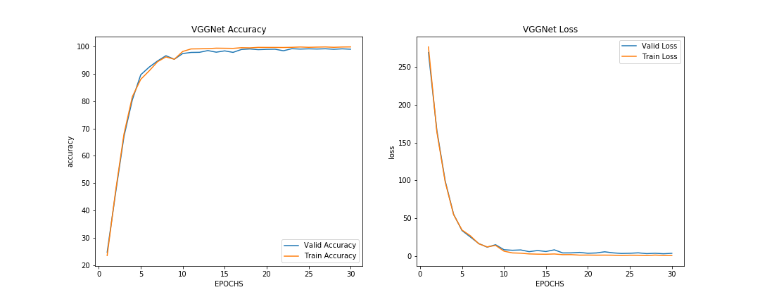
Learning Algorithms – VGGNet – Performance Curve
EPOCH 30 : Training Accuracy = 99.888% Training Loss = 30.000%
EPOCH 30 : Validation Accuracy = 99.048% Validation Loss = 30.000%

Slide 23
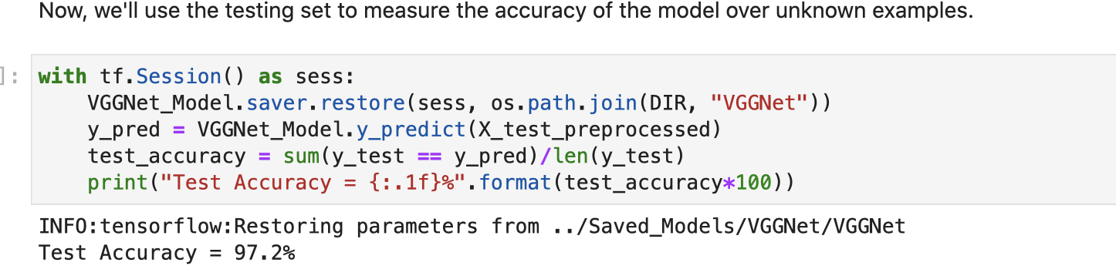
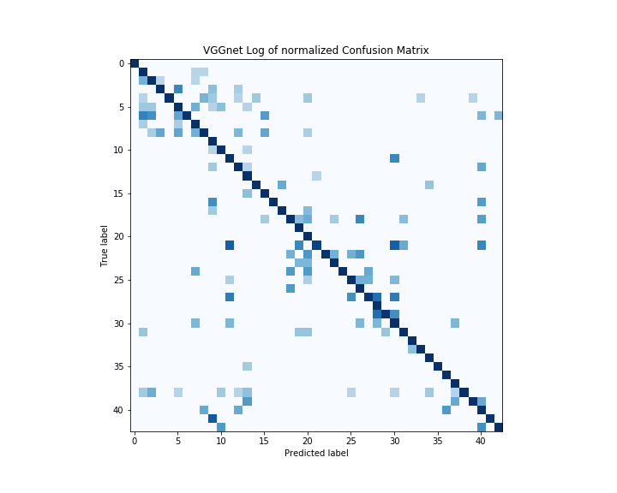
Learning Algorithms – VGGNet - Matrix
Accuracy with Test dataset:
Confusion Metric
Our final VGGNet model has achieved test accuracy of 97.2%.
Conclusion from Confusion Metric chart, we less clusters compare to SVM and MLP and also those two predominately clusters which we have seen in Lenet-5 as well are there but classes ranges has been low 2 – 7 and second is around classes 25 – 29, and these classes range turned out to be speed limits signs and some road signs with triangular shapes.
So our model still misclassified some of the speed signs among themselves and signs with triangular shapes.

Slide 24
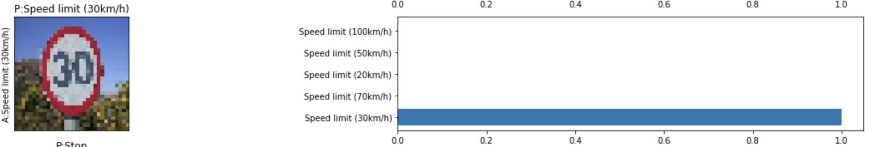
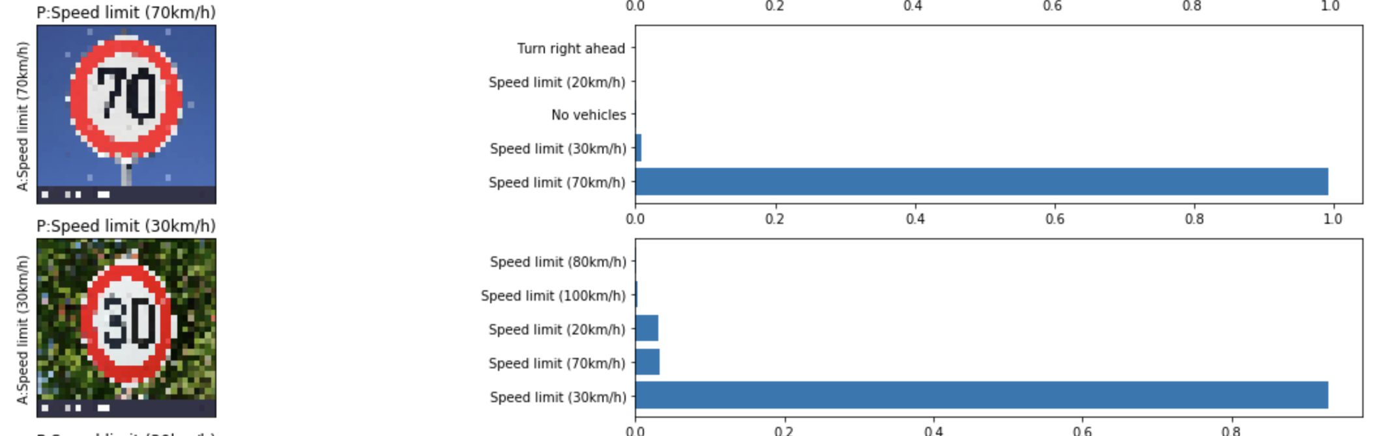
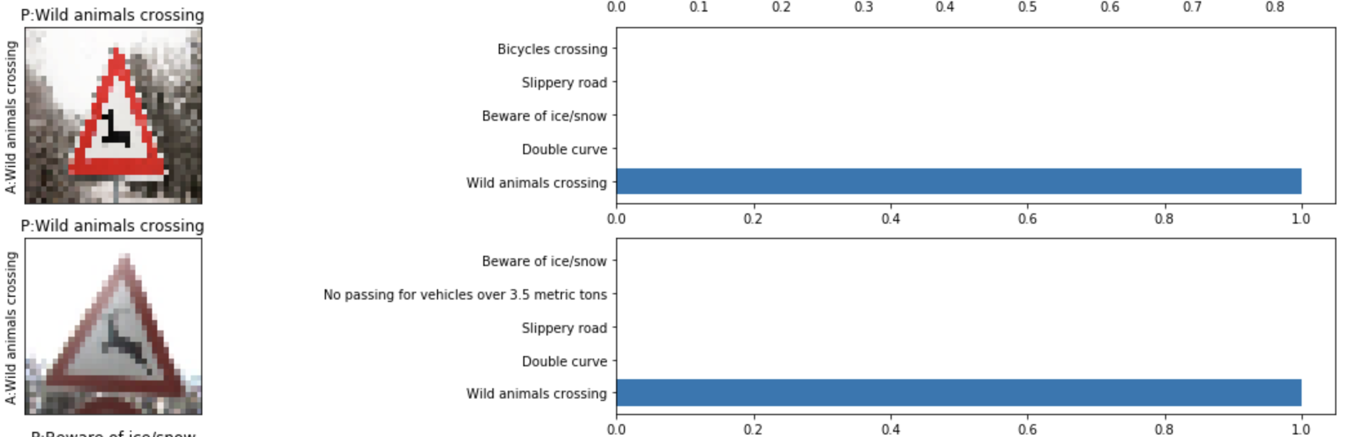
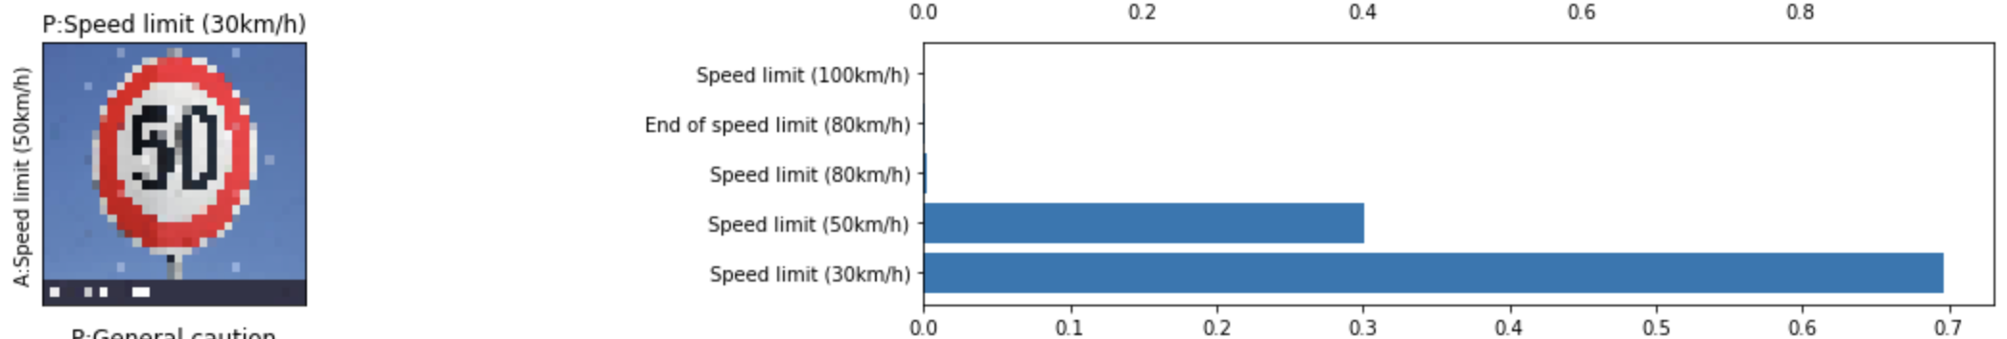
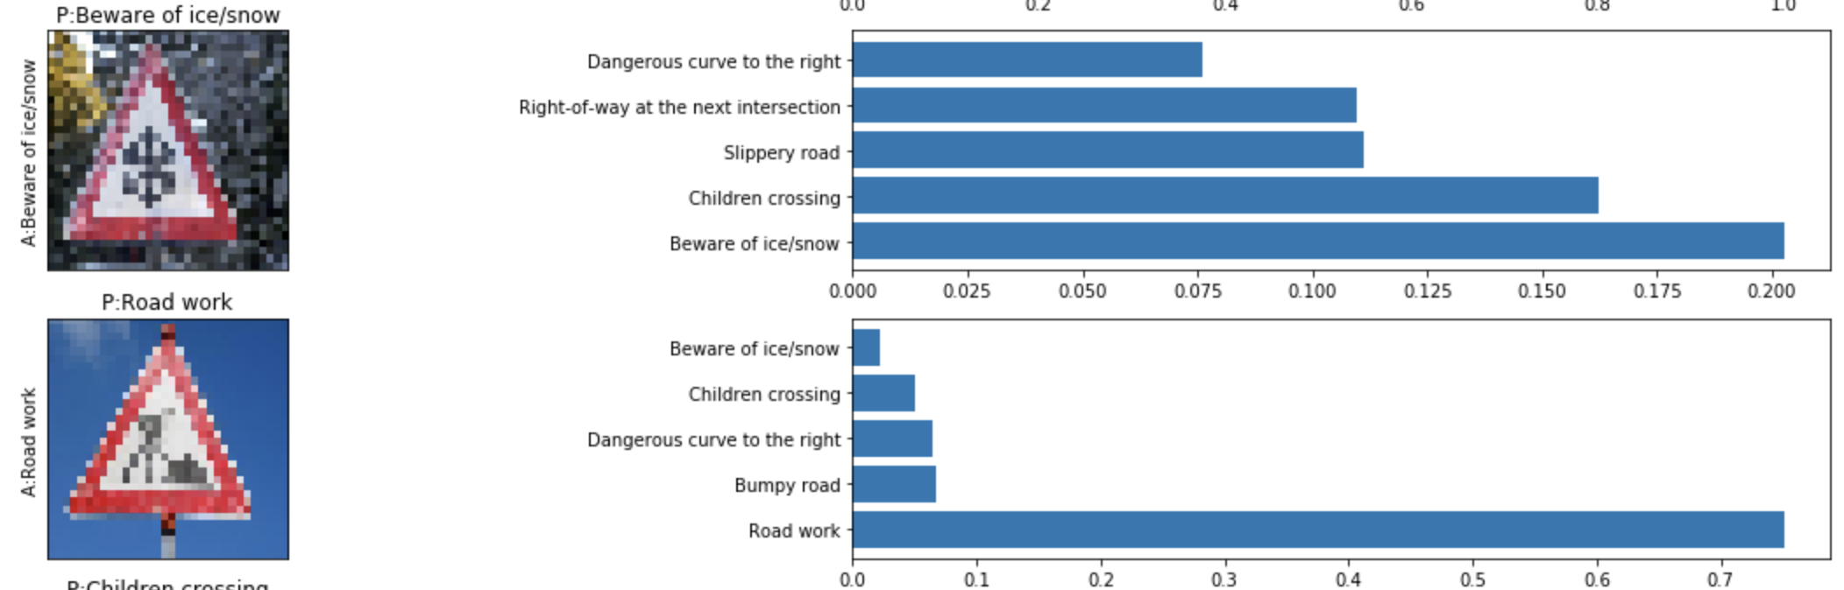
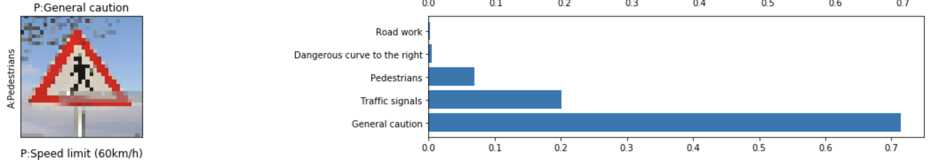
Learning Algorithms – VGGNet – New Images
In order to verify observation we derived from the confusion matrix we created bunch of images which model has never seen at all.

Slide 25
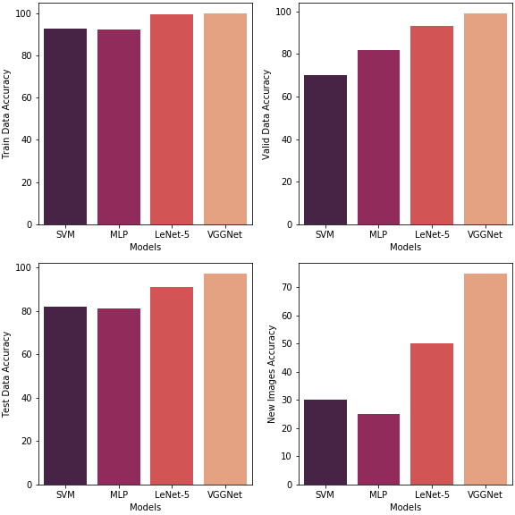
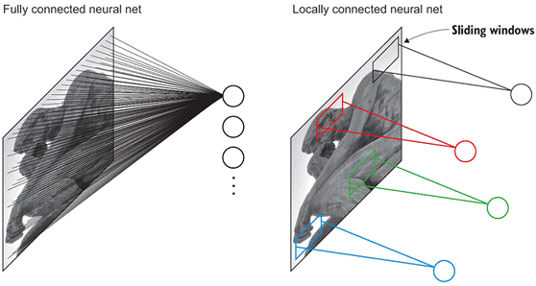
Summary
In this thesis, we have studied right from traditional classification algorithms such as SVM, MLP to state-of-the-art algorithms using Deep Learning. Below table highlight accuracy of used algorithms:
In this thesis, we have studied right from traditional classification algorithms such as SVM, MLP to state-of-the-art algorithms using Deep Learning. Below table highlight accuracy of used algorithms:
1. Flattening the image to a 1D vector input leads to losing the spatial features of 2D images
As we seen in this thesis, before feeding the image to the hidden layers/classification algorithms, we must flatten the image matrix to a 1D vector because SVM/MLPs take a flatten vector as an input. Which means throwing away all the 2D information contained in an image. Treating an input as a simple vector of number with no special structure might work well for 1D signals, like the housing price. But in 2D images, it will lead to information loss because the network doesn’t relate the pixel values to each other when trying to find patterns. SVM/MLPs have no knowledge of the fact that these pixel numbers were originally spatially arranged in a grid and that they are connected to each other.
CNNs on the other hand, do not require flattening the image. We can feed the raw image matrix of pixels to our network. This will allow the CNN to understand that pixels that are close to each other are heavily related than the pixels that are far apart.
2. Fully connected (dense) layers - For MLP ONLY.
MLPs are composed of Dense layers that are fully connected to each other. Fully connected means that every node in one layer is connected to ALL nodes from the previous layer and all nodes in the next layer. In this scenario, each neuron will have parameters (weights) to train per each neuron from the previous layer. if we have an image with dimensions = 32x32), it will yield a million 1024 for each single node in the first hidden layer, it yields to high number of parameters in such a small network.
CNNs on the other hand are locally connected layers. Where their nodes are connected to only a small subset of the previous layers’ nodes. Locally connected layers use far fewer parameters than a densely connected layer as we will see when we discuss CNNs.

Slide 26
Q & A

